Slide 1
Process Creation

Slide 2
fork()
A LINUX system call
Enables a running process to create new process
Newly created process is called child process
Caller process is called parent process

Slide 3
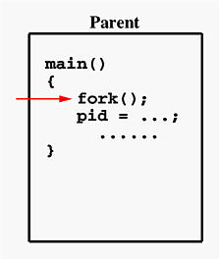
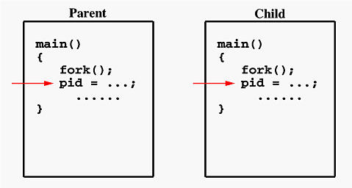
fork()
After a new child process is created, both processes will execute the next instruction after the fork() system call.
NB: Parent will wait,
until the child terminate

Slide 4





fork()
Takes no argument
Returns
Child creation unsuccessful
-1 to parent
Child creation successful
Zero to child
A positive number (child’s process id) to parent
Therefore, testing the return value of fork() can distinguish parent from the child.

Slide 5

Execution
2 possibilities
The parent continues to execute concurrently with its children.
The parent waits until some or all of its children have terminated.

Slide 6
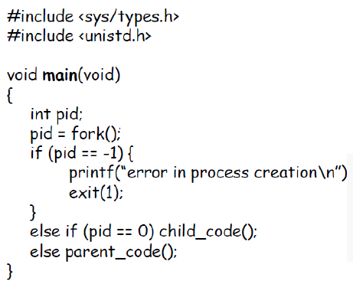

Example

Slide 7

Address Space of Child
Unix will make an exact copy of the parent's address space and give it to the child.
Therefore, the parent and child processes have separate address spaces.

Slide 8
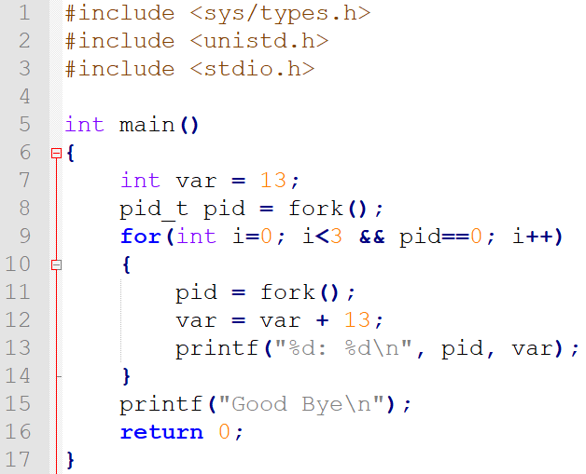
Example
prog7.c

Slide 9
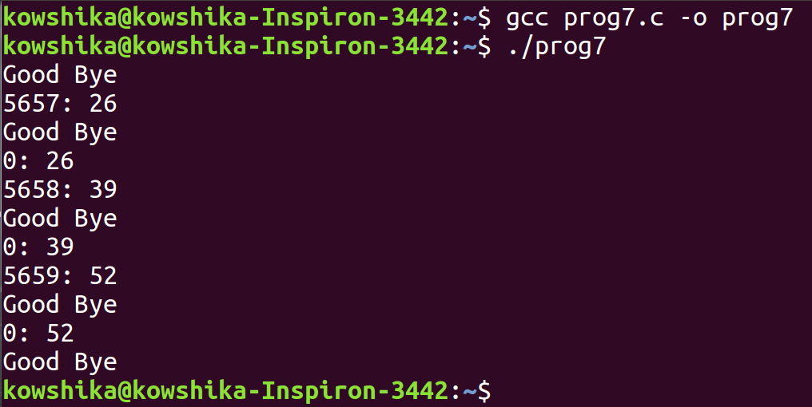
Output

Slide 10
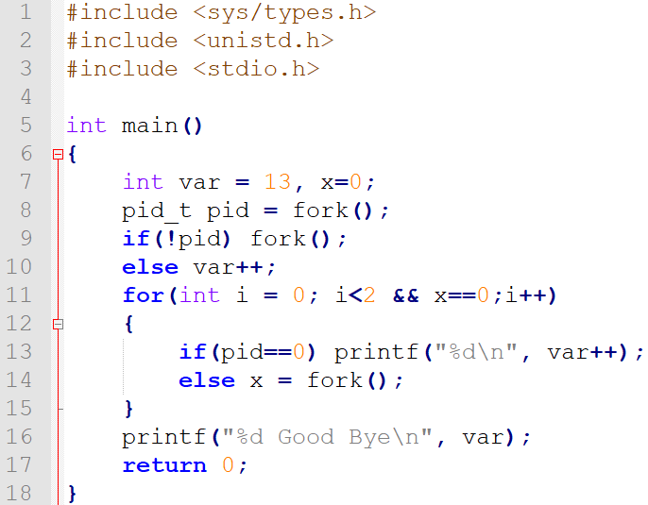
Example
prog8.c

Slide 11
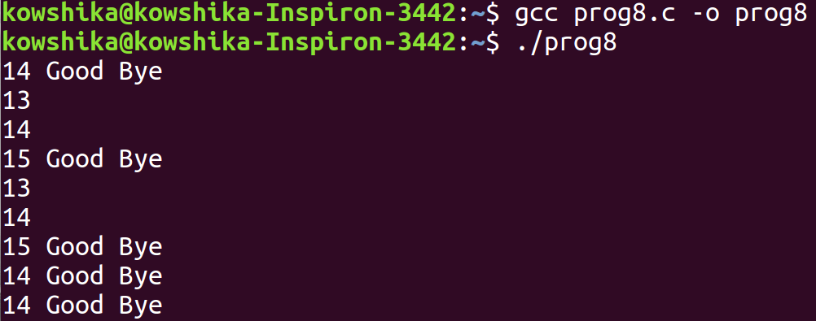
Output

Slide 12
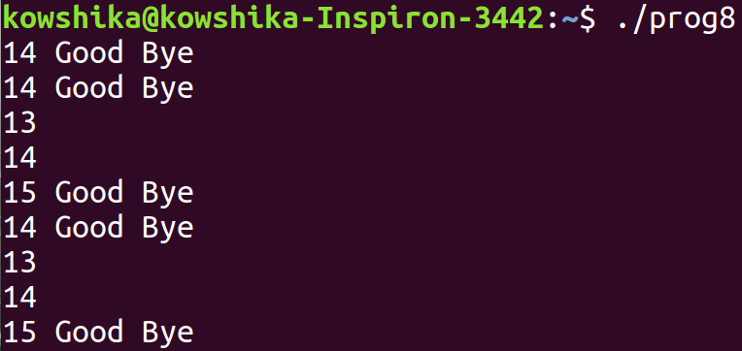
Output
Same output as previous run, in different order

Slide 13
Address Space of Child
exec() can be used after a fork() to replace the child process’ address space with a new program
No new process is not created, the process identifier (PID) does not change, but the machine
code, data, heap, and stack of the process are replaced by those of the new program.

Slide 14
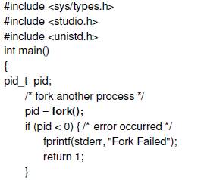
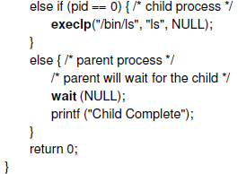
Example

Slide 15
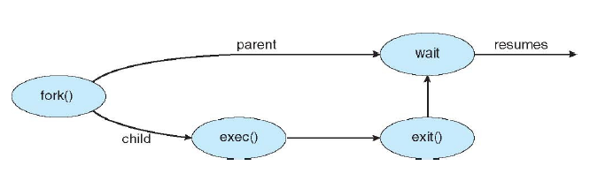
Graphical Representation

Slide 16
Some System Calls
getpid() – returns process id
getppid() – returns parent process id
wait() – suspends execution of calling process until any one of it’s children has terminated
waitpid(#pid) – suspends execution of calling process until a particular child (the one with process id #pid) has terminated

